Slide 1
Jermyn Borough Council Meeting
11/16/2023

Slide 2
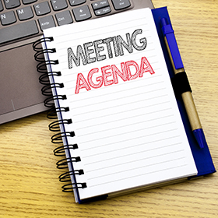
Meeting Agenda
November 16, ,2023
CALL TO ORDER
PLEDGE OF ALLEGIANCE
ROLL CALL
PREVIOUS MEETING MINUTES
TREASURER REPORT/BILLS PAYABLE
SECRETARY REPORT
CORRESPONDENCE
PUBLIC COMMMENT
PROFESSIONAL REPORTS-POLICE, FIRE, SOLICITOR, ZONING, ENGINEER, TAX COLLECTOR, MAYOR
COMMITTEE REPORTS-SAFETY,PLANNING,FINANCE,SHADE TREE,REC,MS4,DPW
2024 BUDGET
NEW BUSINESS

Slide 3
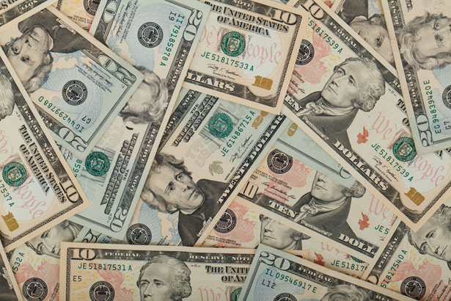
Treasurer’s report
11/16/2023
ASSETS
Checking/Savings
American Rescue Plan Fund 135,733.85
Capital Reserve - DPW 729.48
Capital Reserve - Police 5,339.82
Crime Watch Fund 222.69
General Fund - Community 100,098.79
General Fund - FNB 6,663.32
Holiday Lights Fund 1,459.09

Slide 4
Treasurer’s report
Investment - General Fund 1,054.79
Investment - Liquid Fuels 23,224.40
Investment - Paving Fund 1,065.77
Investment - Recycling 116.50
Investment - Refuse 166.11
Liquid Fuels - FNB 29,249.15
Petty Cash 223.00
Recreations Fund 26,752.25
Recycling - Community 3,364.59
Refuse Checking - FNB 97,438.80
Total Checking/Savings 432,902.40

Slide 5
Treasurer’s report
200000 · Accounts Payable 7,196.48
Long Term Debt 160,133.40

Slide 6


